Slide 1



Feature Selection
#learnaiwithramisha
www.hopelearning.net
@hope_artificial_intelligence

Slide 2
#learnaiwithramisha
Why feature Selection?
www.hopelearning.net
@hope_artificial_intelligence

Slide 3
#learnaiwithramisha
Feature Selection Method Vs Dimensionality Reduction
Feature Selection Method
Dimensionality Reduction
The input variable values are converted into cluster feature.
It selects the important feature among the input features variable.
Based on the user input it selects the number of feature
Based on the user input it selects the number of clusters
No change in the data value
Change in the data value.
www.hopelearning.net
@hope_artificial_intelligence

Slide 4
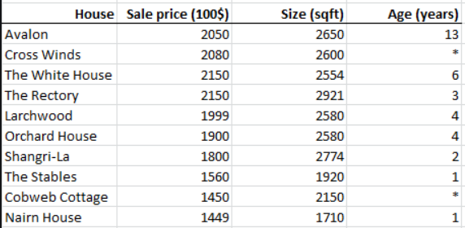
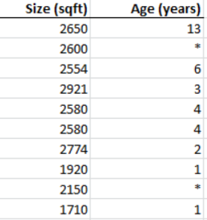
#learnaiwithramisha
All the feature Variable
I₁
I₂
I₃
I₄
Feature Selection Method
It selects the important feature among the input features variable.
After the feature selection method
Based on the user input it selects the number of feature
No change in the data value
www.hopelearning.net
@hope_artificial_intelligence

Slide 5
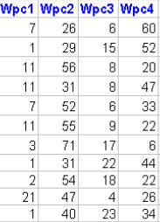
#learnaiwithramisha
All the feature Variable
I₁
I₂
I₃
I₄
Dimensionality Reduction
The input variable values are converted into cluster feature.
Based on the user input it selects the number of clusters
After the PCA method
Change in the data value.
www.hopelearning.net
@hope_artificial_intelligence

Slide 6
#learnaiwithramisha
Dimensionality Reduction
Feature Selection Method
SelectK Algorithm
Recursive Feature Elimination
Feature Importance
Chi Square, RMS
Principle Component Analysis
Linear Discriminant Analysis
Kernel PCA
Each Variable with output
Changing Each Variable Value ,changes in the output
Forward Selection
Backward Selection
Based on Correlation
Based on Correlation
www.hopelearning.net
@hope_artificial_intelligence

Slide 7
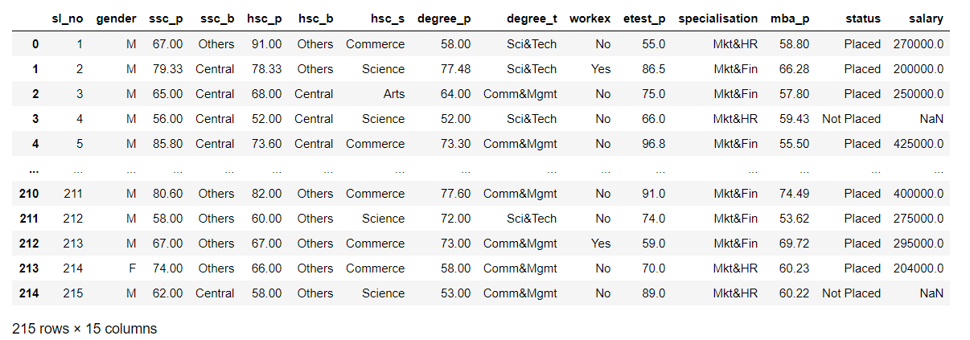
#learnaiwithramisha
Dataset
www.hopelearning.net
@hope_artificial_intelligence

Slide 8


#learnaiwithramisha
SelectK Algorithm
Chi Square, RMS
Chi Square= 0.8
www.hopelearning.net
@hope_artificial_intelligence

Slide 9

#learnaiwithramisha
SelectK Algorithm
Chi Square, RMS
Chi Square= 0.85
www.hopelearning.net
@hope_artificial_intelligence

Slide 10

#learnaiwithramisha
SelectK Algorithm
Chi Square, RMS
Chi Square= 0.75
www.hopelearning.net
@hope_artificial_intelligence

Slide 11

#learnaiwithramisha
SelectK Algorithm
Chi Square, RMS
Chi Square= 0.90
www.hopelearning.net
@hope_artificial_intelligence

Slide 12
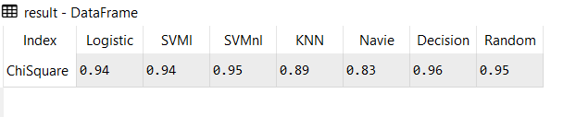
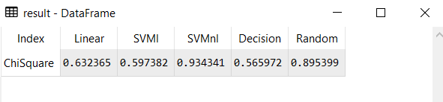
#learnaiwithramisha
Select K Best
K=3
Classification
Regression
www.hopelearning.net
@hope_artificial_intelligence

Slide 13
#learnaiwithramisha
Recursive Feature Elimination
Each Variable with output
machine learning algorithm 1=0.78
machine learning algorithm 2=0.80
www.hopelearning.net
@hope_artificial_intelligence

Slide 14
#learnaiwithramisha
Recursive Feature Elimination
Each Variable with output
machine learning algorithm 1=0.78
machine learning algorithm 2=0.80
www.hopelearning.net
@hope_artificial_intelligence

Slide 15
#learnaiwithramisha
Recursive Feature Elimination
Each Variable with output
machine learning algorithm 1=0.60
machine learning algorithm 2=0.85
www.hopelearning.net
@hope_artificial_intelligence

Slide 16
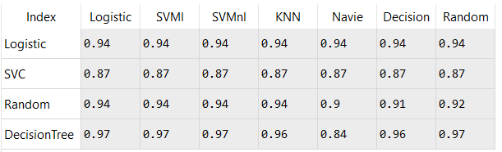
#learnaiwithramisha
Recursive Feature Elimination
Each Variable with output
Classification
www.hopelearning.net
@hope_artificial_intelligence

Slide 17
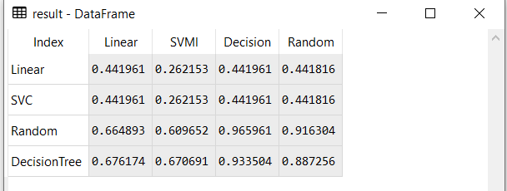
#learnaiwithramisha
Recursive Feature Elimination
Each Variable with output
Regression
www.hopelearning.net
@hope_artificial_intelligence

Slide 18
#learnaiwithramisha
Feature Importance
Changing Each Variable Value ,changes in the output
R2=0.78
www.hopelearning.net
@hope_artificial_intelligence

Slide 19
#learnaiwithramisha
Feature Importance
Changing Each Variable Value ,changes in the output
R2=0.80
www.hopelearning.net
@hope_artificial_intelligence

Slide 20
#learnaiwithramisha
Select K Best
K=3
Classification
Regression
www.hopelearning.net
@hope_artificial_intelligence

Slide 21









#learnaiwithramisha
Recursive Feature Elimination
Each Variable with output
Classification
www.hopelearning.net
@hope_artificial_intelligence

Slide 22
#learnaiwithramisha
Recursive Feature Elimination
Each Variable with output
Regression
www.hopelearning.net
@hope_artificial_intelligence

Slide 23

Two phase of Artificial Intelligence
Two phase of Artificial Intelligence
Model Creation
Deployment / production/Implement
www.hopelearning.net
#learnaiwithramisha
@hope_artificial_intelligence

Slide 24
Model creation/Learning
Data collection
Data preprocessing
Analysis the Data-Univariate and Bivariate
Input/output split
Feature Selection/dimensionality Reduction
Split train and test
Train set
Test set
Evaluation Metrics
Model creation
save the best model
www.hopelearning.net
#learnaiwithramisha
@hope_artificial_intelligence

Slide 25
Deployment
Load the saved model
Get inputs
Predicts
Call to action
www.hopelearning.net
#learnaiwithramisha
@hope_artificial_intelligence

Slide 27

#learnaiwithramisha
Dimensionality Reduction
Dimensionality Reduction
Already we have feature selection methodology
Then why PCA?
www.hopelearning.net
@hope_artificial_intelligence

Slide 28
#learnaiwithramisha
Scalar and Vector
Scalar→ Magnitude
10
5
2
3
www.hopelearning.net
@hope_artificial_intelligence

Slide 29
#learnaiwithramisha
Scalar and Vector
Vector→ Magnitude & Direction
M=5,D=R
M=8,D=U
M=2,d=D
M=10,D=L
www.hopelearning.net
@hope_artificial_intelligence

Slide 30
#learnaiwithramisha
Dimension
Zero Dimension
One Dimension
Two Dimension
Three Dimension
N-Dimension
www.hopelearning.net
@hope_artificial_intelligence

Slide 31
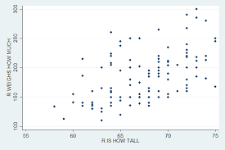
#learnaiwithramisha
Principle Component Analysis
www.hopelearning.net
@hope_artificial_intelligence

Slide 32
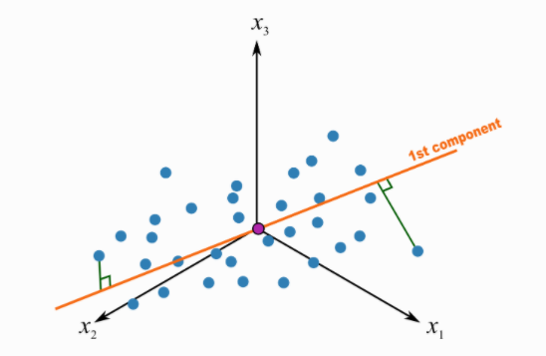
#learnaiwithramisha
Principle Component Analysis
www.hopelearning.net
@hope_artificial_intelligence

Slide 33
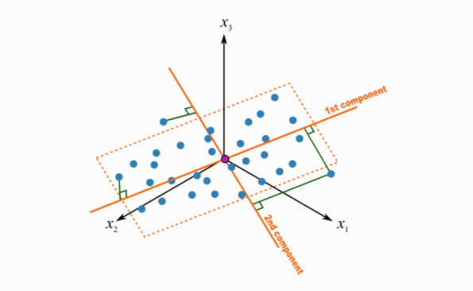
#learnaiwithramisha
Principle Component Analysis
www.hopelearning.net
@hope_artificial_intelligence

Slide 34
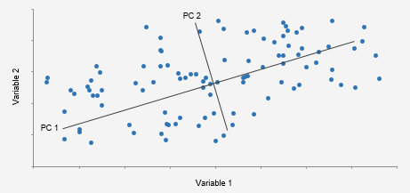
#learnaiwithramisha
Principle Component Analysis
www.hopelearning.net
@hope_artificial_intelligence

Slide 35
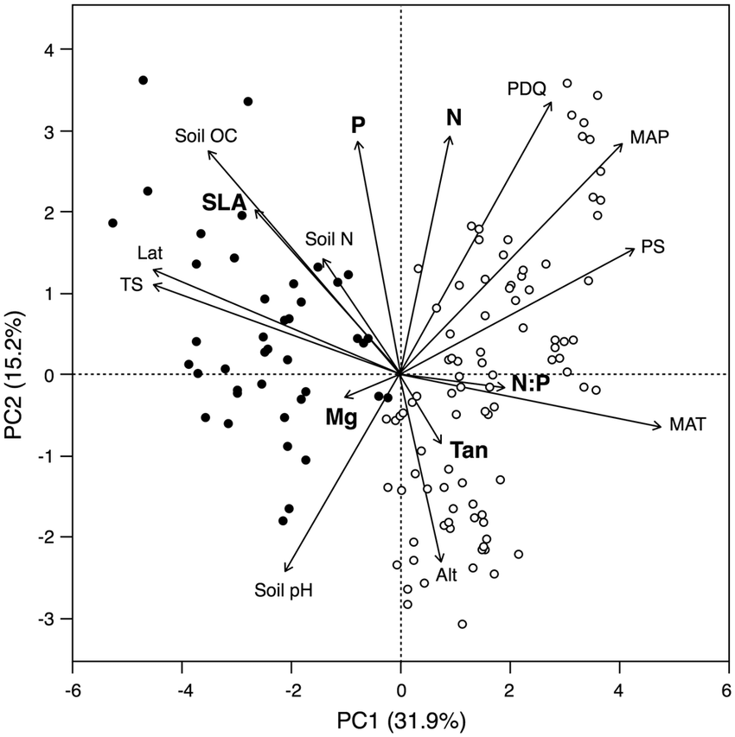
#learnaiwithramisha
Principle Component Analysis
www.hopelearning.net
@hope_artificial_intelligence

Slide 36
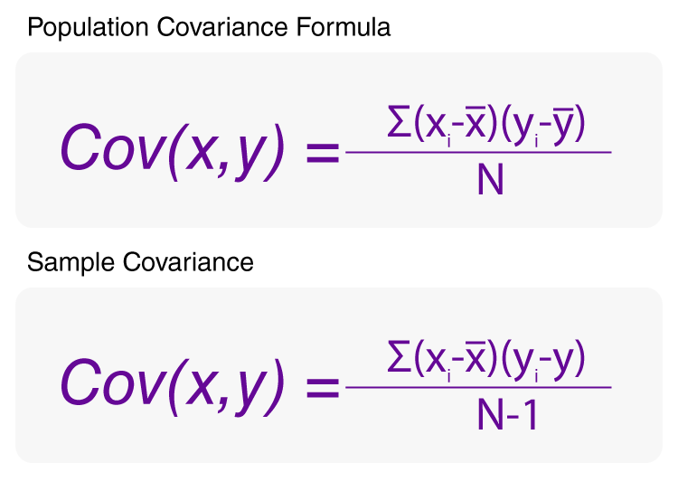
#learnaiwithramisha
Eigen Value and Eigen vector In PCA
Dataset
Matrix for
Eigen Value and
Eigen Vectors
www.hopelearning.net
@hope_artificial_intelligence

Slide 37
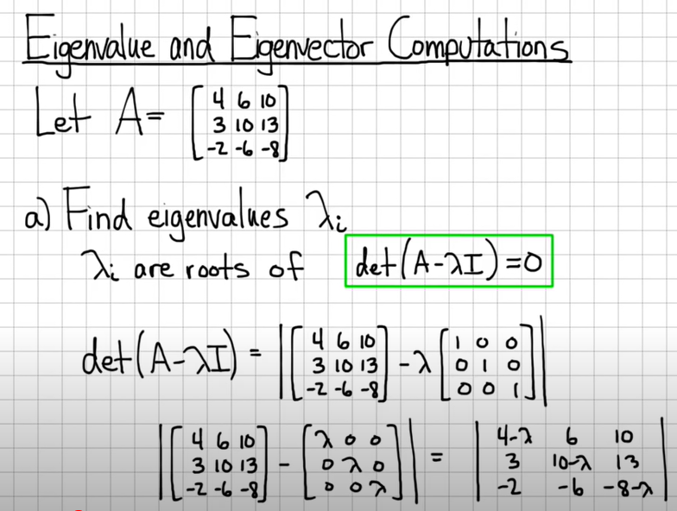
#learnaiwithramisha
Eigen Value and Eigen vector In PCA
www.hopelearning.net
@hope_artificial_intelligence

Slide 38
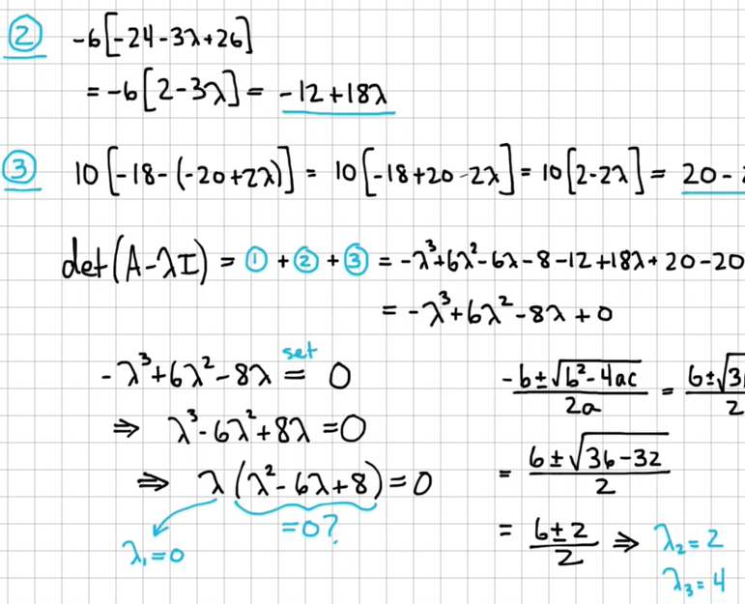
#learnaiwithramisha
Eigen Value and Eigen vector In PCA
www.hopelearning.net
@hope_artificial_intelligence

Slide 39
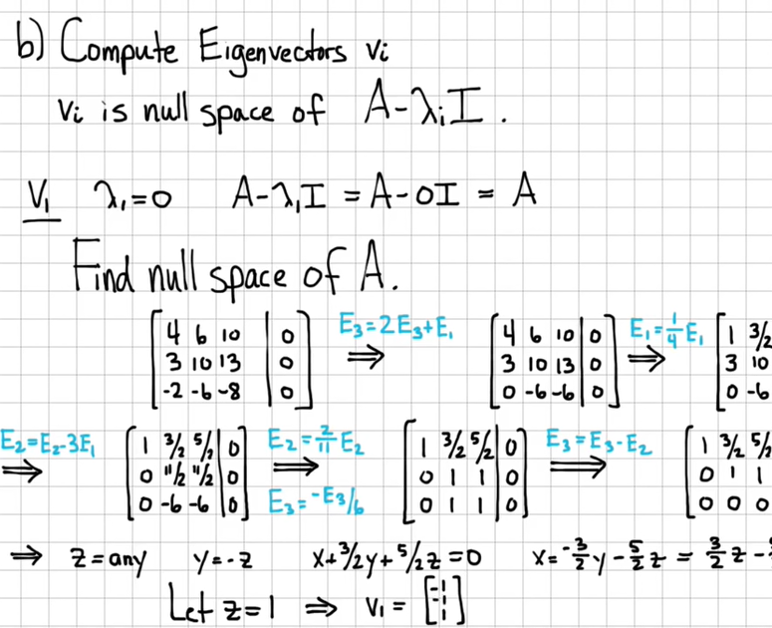
#learnaiwithramisha
Eigen Value and Eigen vector In PCA
www.hopelearning.net
@hope_artificial_intelligence

Slide 40
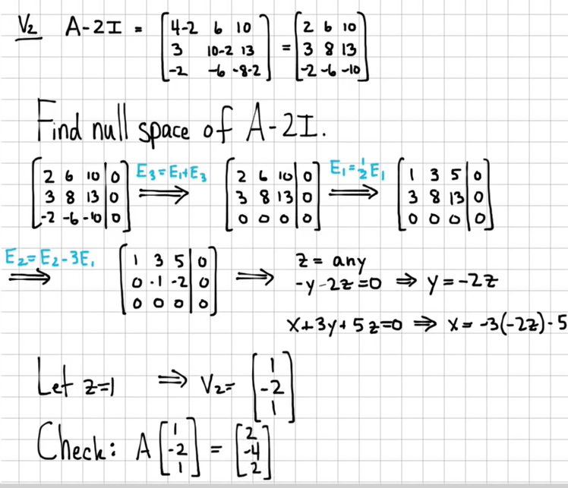
#learnaiwithramisha
Eigen Value and Eigen vector In PCA
www.hopelearning.net
@hope_artificial_intelligence

Slide 41
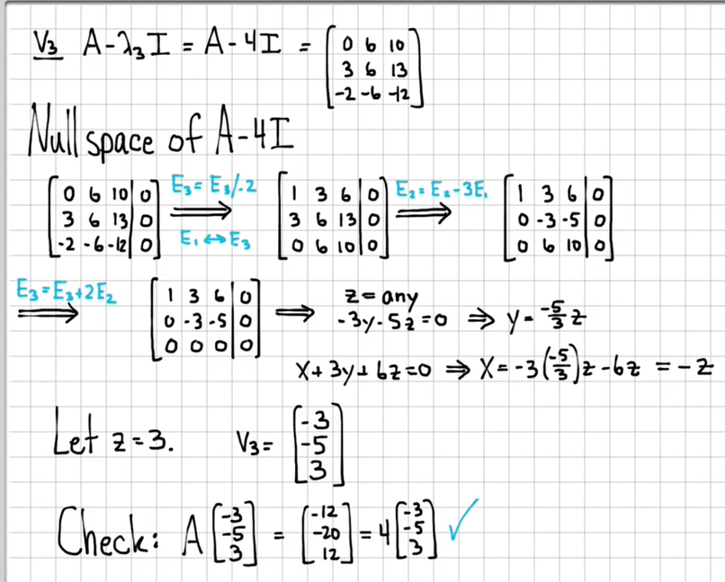
#learnaiwithramisha
Eigen Value and Eigen vector In PCA
www.hopelearning.net
@hope_artificial_intelligence

Slide 42


#learnaiwithramisha
Eigen Value and Eigen vector In PCA
www.hopelearning.net
@hope_artificial_intelligence

Slide 43
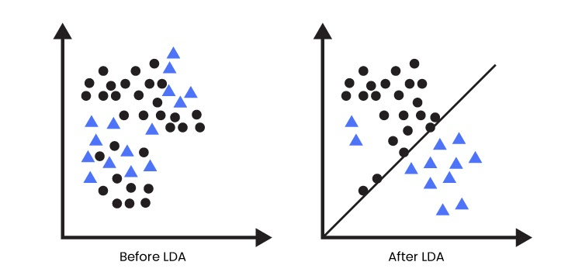
#learnaiwithramisha
Linear Discriminant Analysis
www.hopelearning.net
@hope_artificial_intelligence

Slide 44
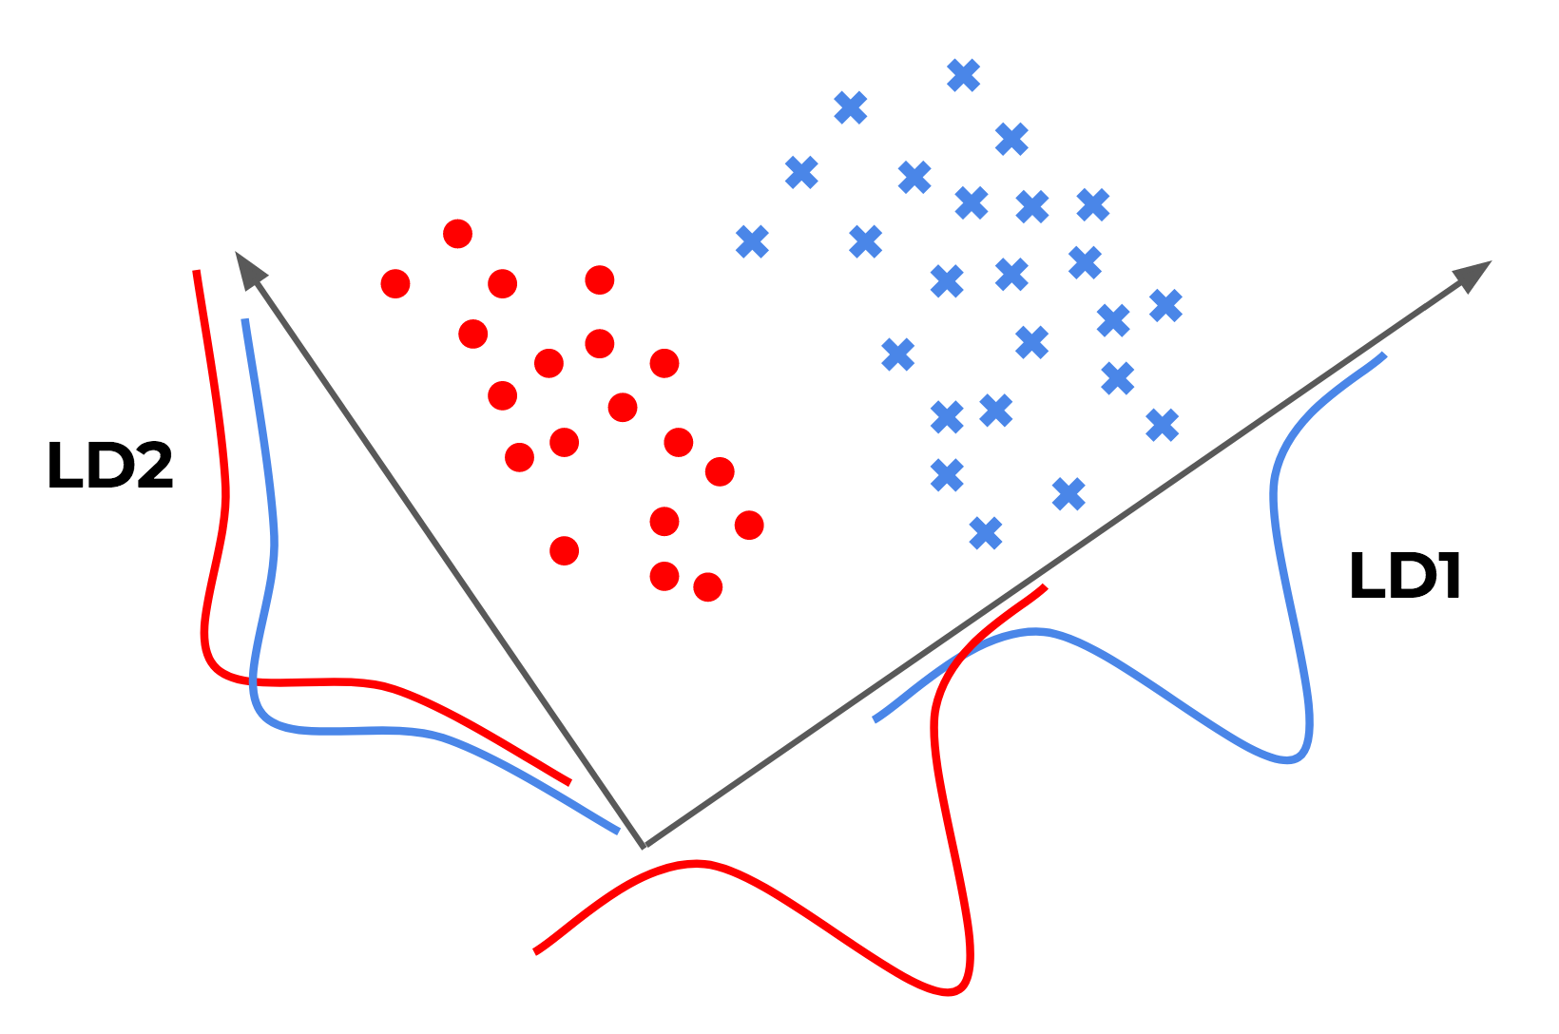
#learnaiwithramisha
Linear Discriminant Analysis
www.hopelearning.net
@hope_artificial_intelligence

Slide 45
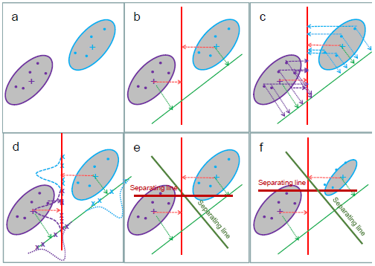
#learnaiwithramisha
Linear Discriminant Analysis
www.hopelearning.net
@hope_artificial_intelligence

Slide 46
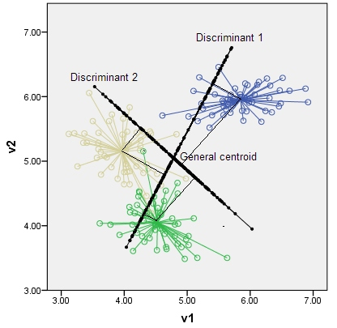
#learnaiwithramisha
Linear Discriminant Analysis
www.hopelearning.net
@hope_artificial_intelligence

Slide 47
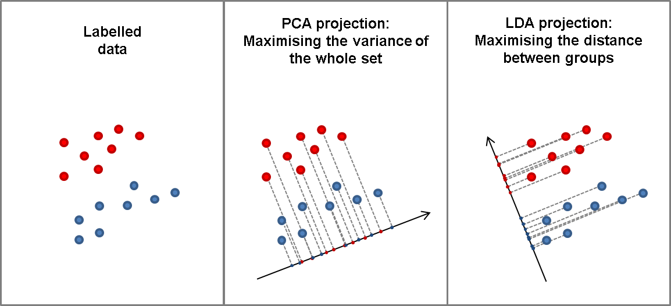
#learnaiwithramisha
Linear Discriminant Analysis
www.hopelearning.net
@hope_artificial_intelligence

Slide 48
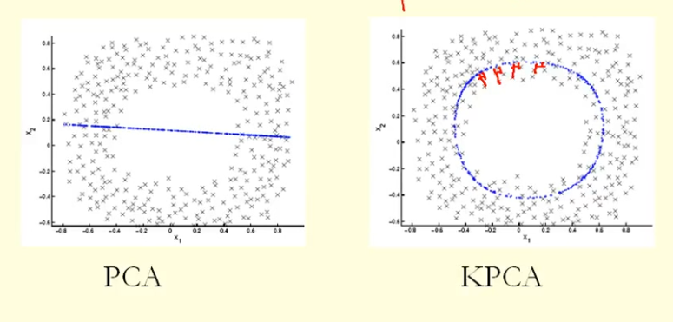
#learnaiwithramisha
Kernel PCA
www.hopelearning.net
@hope_artificial_intelligence

